Slide 1
AI-Based Smart Energy Consumption Forecasting & Advisor Presented by: Gangode Prathmesh Raghunath Internship: 1M1B AI for Sustainability Virtual Internship In collaboration with: IBM Skills Build & AICTE

Slide 2
Problem Statement
Energy consumption is increasing across homes, educational institutions, offices, and other buildings.
However, users often lack a simple way to:
Understand their energy consumption patterns
Predict future energy demand
Identify unusually high consumption
Recognize peak-demand periods
Take timely action to reduce unnecessary energy usage

Slide 3
Proposed Solution
AI-Based Smart Energy Advisor
The proposed system combines Machine Learning, anomaly detection, and decision-support recommendations.
How it works:
Collect / generate energy consumption data
Preprocess the data
Analyze energy usage patterns
Train multiple ML models
Select the best-performing model
Forecast energy consumption
Detect unusual consumption patterns
Generate simple energy-saving recommendations
Display results through an interactive dashboard

Slide 4
AI & Technologies Used
Technologies
Programming & Development
Python
Google Collab
GitHub
Data Processing
Pandas
NumPy
Visualization
Matplotlib
Dashboard
Gradio

Slide 5
Machine Learning Model Development
Models Compared
Three regression models were trained and evaluated:
Best Model
Random Forest Regressor
It achieved the lowest MAE and RMSE and the highest R² among the tested models.
Interpretation
R² ≈ 0.958
The model captured most of the variation in the test dataset.
Model | MAE | RMSE | R²
Random Forest | 1.77 | 2.25 | 0.958
Gradient Boosting | 1.87 | 2.38 | 0.953
Linear Regression | 2.55 | 3.15 | 0.917

Slide 6
Feature Importance & Anomaly Detection
The Random Forest model identified the following as the strongest features:
Feature | Importance
Occupancy | 0.798
Previous Day Consumption | 0.076
Temperature | 0.037
Peak Hour | 0.034
Day of Week | 0.019

Slide 7
Key Observation
Occupancy was the strongest feature in the current dataset, indicating a strong relationship between building occupancy and energy demand.
Anomaly Detection
Using Isolation Forest:
Total records: 8,760
Normal: 8,584
Unusual: 176

Slide 8
Smart Energy Advisor & Dashboard
It provides simple recommendations based on factors such as:
Predicted energy demand
Temperature
Occupancy
Peak-hour usage
Unusual consumption patterns
Interactive Dashboard
The Gradio dashboard provides:
Energy Prediction
Energy Analytics
ML Performance
Feature Importance
Project Information
Responsible AI

Slide 9
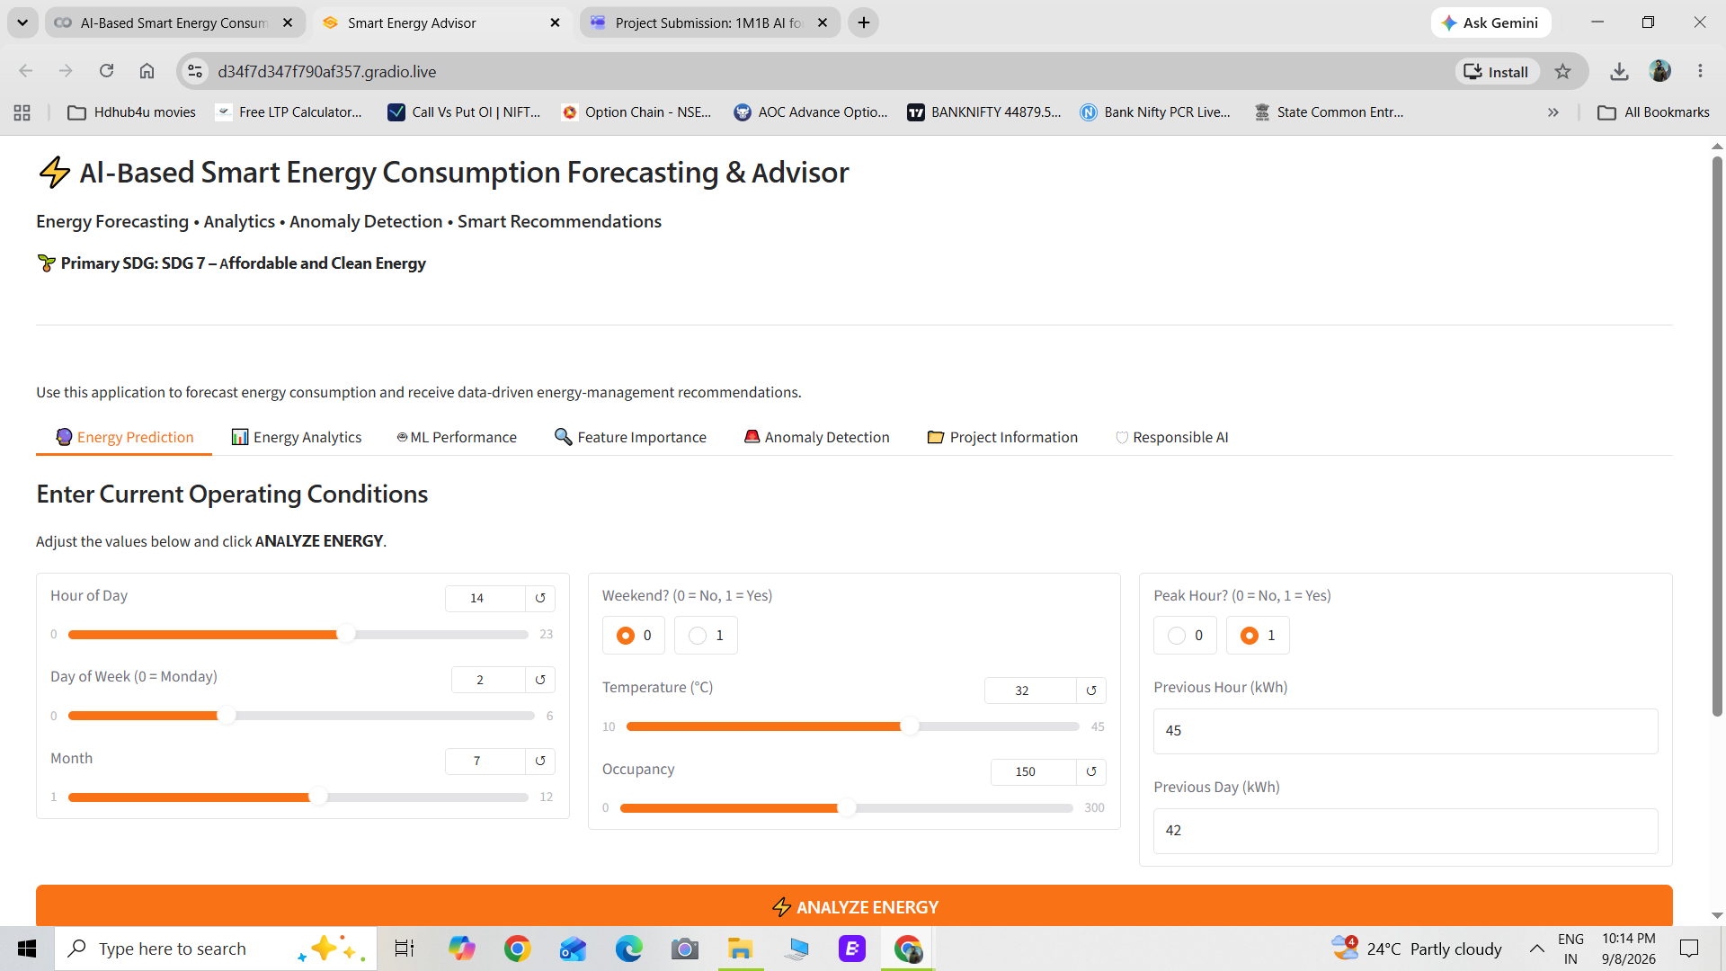
Dashboard

Slide 10
Future Scope
Real-Time Data
Connect smart meters and IoT energy sensors.
Energy Cost Prediction
Include electricity tariffs and estimate future bills.
Renewable Energy Integration
Add solar PV generation forecasting.
Mobile-Friendly Platform
Make the advisor accessible through mobile devices.

Slide 11
Conclusion
The project demonstrates how AI and Machine Learning can be applied to sustainable energy management.
The developed prototype can:
Predict → Detect → Analyze → Advise
It combines:
Machine Learning forecasting
Anomaly detection
Energy analytics
Decision-support recommendations
Interactive visualization

Slide 12
Project Links & Thank You
GitHub Repository: https://github.com/Prathmg/AI-Based-Smart-Energy-Consumption-Forecasting-Advisor

